Slide 1
Distributing Products Quickly and Effectly
Dr. Péter POPOVICS PhD.
Assistant professor, coach
Dept. Enterprise Development Team Academy Debrecen
By：Ruan Xinyu

Slide 2
By getting into distribution and production, “I am actually widening my base”.

Slide 3
Concept of Distribution

Slide 4
Marketing Intermediaries and Channel of Distribution

Slide 5
Intermediaries and Efficiency.

Slide 6
Distribution Cost/1$.

Slide 7
Intermediaries create utility.

Slide 9
Wholesale intermediaries

Slide 10
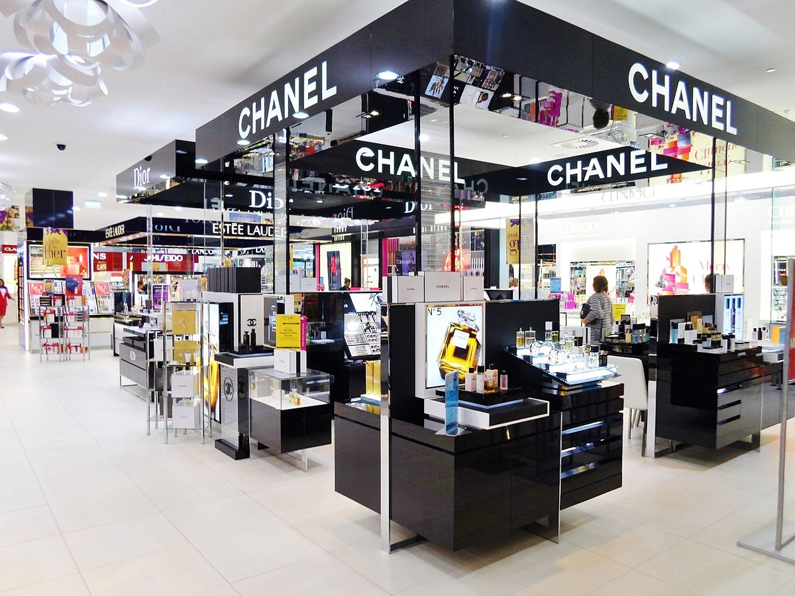
Retail Stores and Types.

Slide 11
Forms of Non-Store Retailing

Slide 12
4 Distribution Channel Systems.

Slide 13
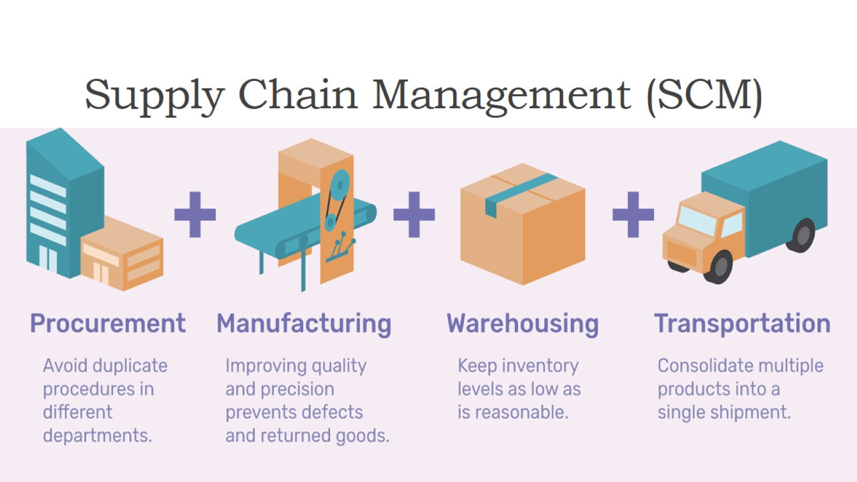
Supply Chain Management (SCM)

Slide 14
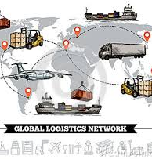
Modes of Logistics
Truck Freight — Road Transportation. ...
Ship — Marine Transportation. ...
Train — Rail Transportation. ...
Plane — Air Transportation.

Slide 15
Questions?

Slide 16
Answers!!

