Slide 1
Distributing products
Chapter 15

Slide 2
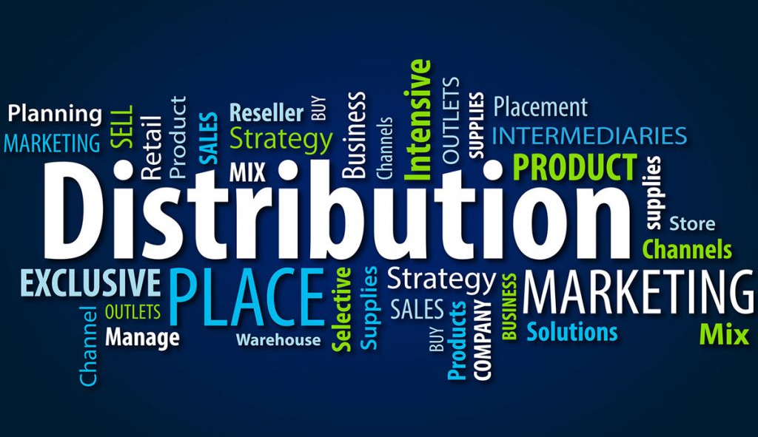
Content
The concepts of marketing channels and their value Demonstrate how Intermediaries perform the six marketing utilities The types of wholesale Intermediaries in the distribution system The distribution strategies retailers use

Slide 3
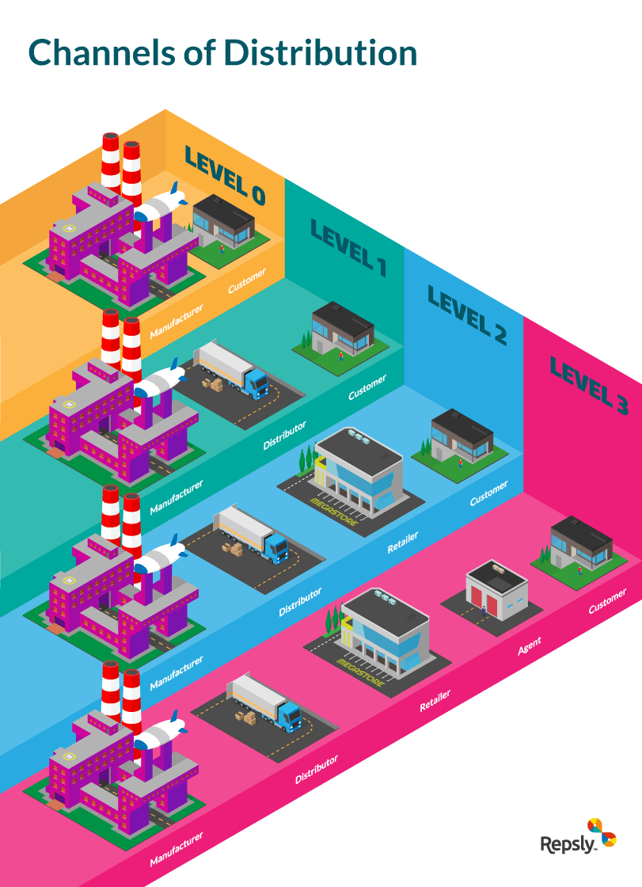
The concept of marketing channels and their value
A distribution channel refers to the flow of business, there are direct and indirect channels,
The emergence of marketing intermediaries
Channels of distribution help ensure communication flows and the flow of money and title to goods. They also help ensure that the right quantity and assortment of goods will be available when and where needed.
Marketing needs intermediaries
Definition
Marketing intermediaries: Organizations that assist in moving goods and services from producers to businesses (B2B) and from businesses to consumers (B2C).
Channel of distribution: A whole set of marketing intermediaries, such as agents, brokers, whole-salers, and retailers, that join together to transport and store goods in their path (or channel) from producers to consumers.
Agent / brokers: Marketing intermediaries who bring buyers and sellers together and assist in negotiating an exchange but don’t take title to the goods.

Slide 4
The concept of marketing channels and their value
Intermediaries create exchange efficiency
The value versus the cost of intermediaries
Definition
Wholesaler: A marketing intermediary that sells to other organizations (B2B).
Retailer: An organization that sells to ultimate consumers.

Slide 5
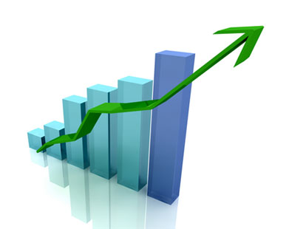
The six marketing utilities performed by the intermediaries
Form utility: Changing raw materials into useful products.
Time utility: Adding value to products by making them available when they’re needed.
Place utility: Adding value to products by having them where people want them.
Possession utility: Doing whatever is necessary to Possessiontransfer ownership from one party to another, including providing credit, delivery, installation, guarantees, and follow-up service.
Information utility: Adding value to products by opening two-way flows of information between marketing participants.
Service utility: Adding value by providing fats, friendly service during and after the sale and by teaching customers how to best use products over time.
Definition
Utility: in economics, the want-satisfying ability, or value, that organizations add to goods or services. By making them more useful or accessible to consumers than they were before.

Slide 6
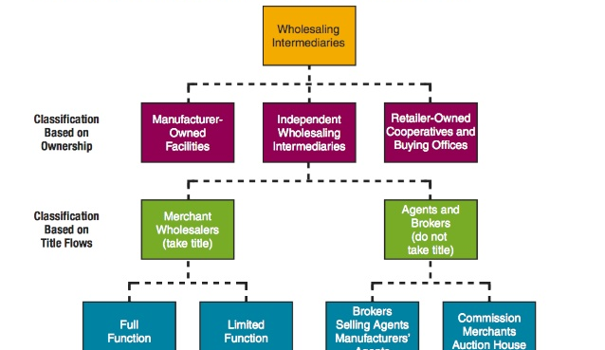
The types of wholesale intermediaries in the distribution system
Merchant wholesalers: independently owned firms that take title to the goods they handle.
Rack jobbers: wholesalers that furnish racks or shelves full of merchandise to retailers, display products, and sell on consignment.
Cash and carry wholesalers: wholesalers that serve mostly smaller retailers with a limited assortment of products.
Drop shippers: wholesalers that solicit orders from retailers and other wholesalers, and have the merchandise shipped directly from a producer to a buyer.

Slide 7
The distribution strategies retailers use
Intensive Distribution: As many outlets as possible. The goal of intensive distribution is to penetrate as much of the market as possible.
Selective Distribution: Select outlets in specific locations. This is often based on a particular good and its fit within a store. Doing this allows manufacturers to pick a price point that targets a specific market of consumer, therefore providing a more customized shopping experience. Selective distribution caps the number of locations in a particular area.
Exclusive Distribution: Limited outlets. This can mean anything from luxury brands that are exclusive to special collections available only in particular locations or stores. This method helps maintain a brand’s image and product exclusivity.

Slide 8
Case study

Slide 9
Questions
What is a marketing intermediary ?
Organizations that assist in moving goods and services from producers to businesses (B2B) and from businesses to consumers (B2C).
How many marketing utilities exist?
6 :
Form
Place
Time
Possession
Information
Service
What are the 3 distribution strategies that retailers use ?
Intensive
Selective
Exclusive

Slide 10
Thank you for your kind attention!

