Slide 1







Introduction to data-driven critical thinking
Data Quality

Slide 2
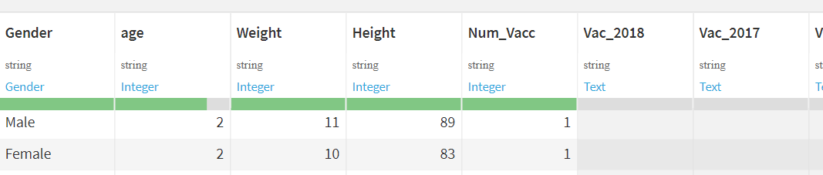
Data Quality
Types of data
When importing a dataset, it is common for Dataiku to read most variables as String
It is necessary to review this import, and correctly define the variables as Integers, Float, Date, or even other types such as Boolean

Slide 3
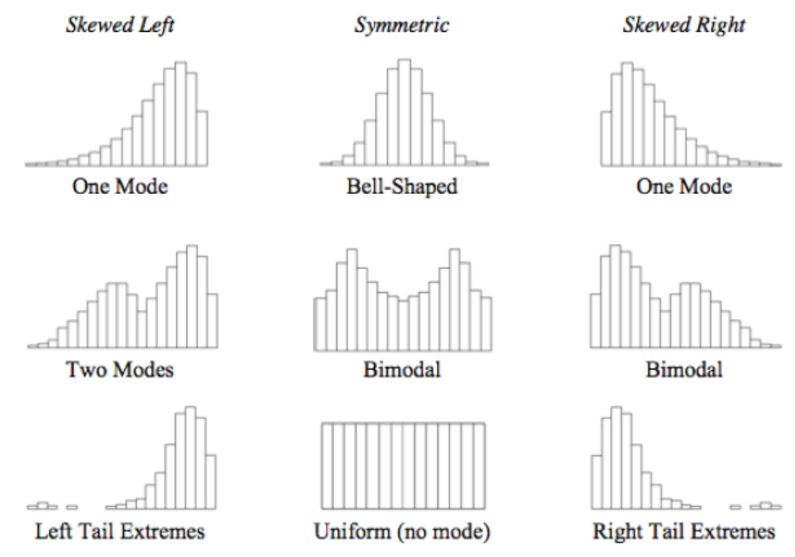
Data Quality
Outliers
Outliers are observations that lie outside the overall pattern of a distribution

Slide 4
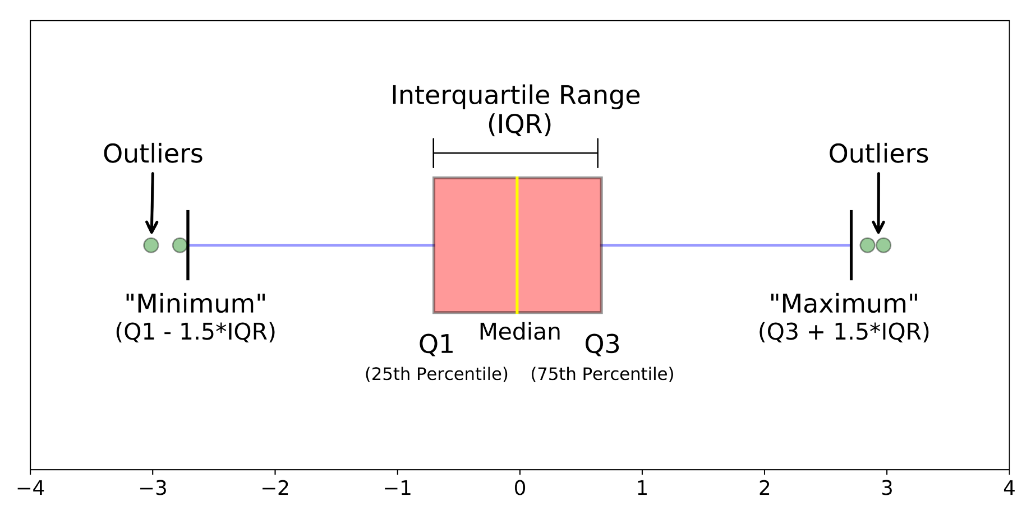
Data Quality
Boxplot for identification of outliers
Boxplots are useful for the identification of outliers

Slide 5
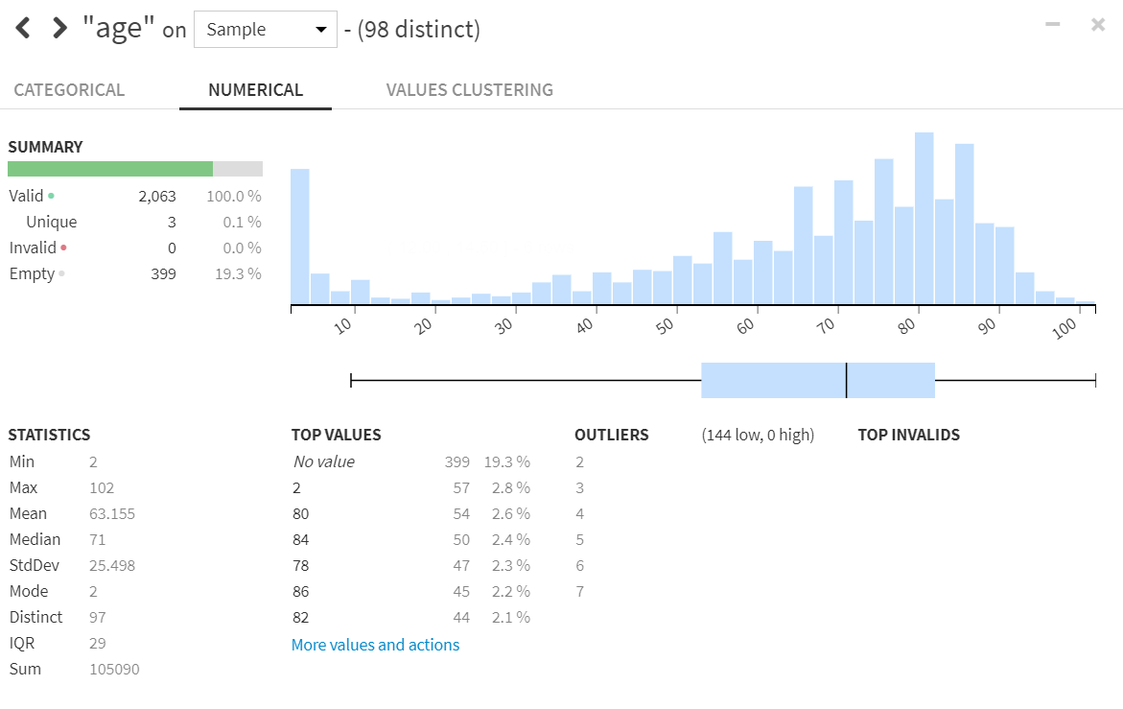
Data Quality
Histograms for identification of outliers
Histograms for identification of outliers

Slide 6
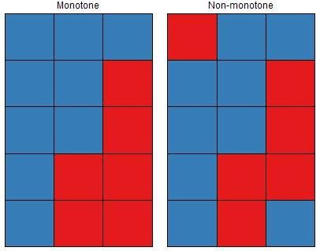
Data Quality
Missing data
Most techniques for data analysis and modeling are robust to the presence of missing values
A high percentage of missing values in a variable makes the results less reliable
It is important to understand the cause of missing values and verify that missing data is due to random causes

Slide 7
Introduction to data-driven critical thinking
Data Quality

